Slide 1
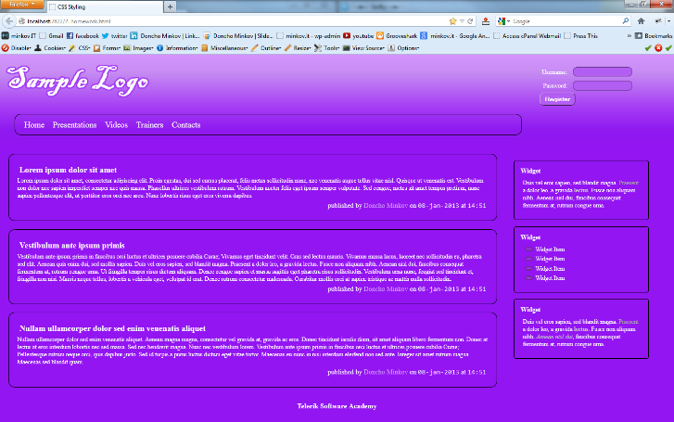
Homework
Implement the following using either LESS or SASS
Use the HTML code from homework.html
Create the LESS/SASS easy to change (colors, fonts)
Use mixins for clears, gradients)
Source can be found in Preprocessors-homework.zip

Slide 2
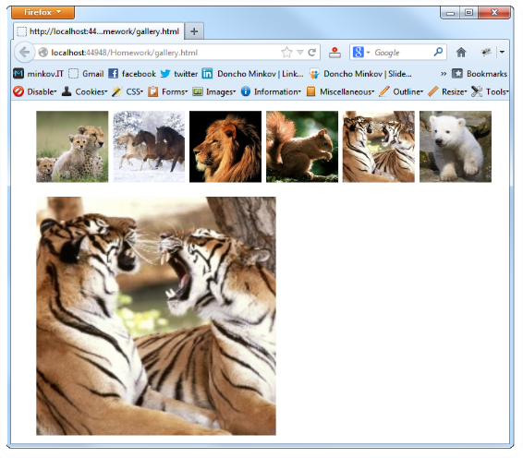
Homework (2)
Create a web gallery
Use only HTML, LESS or SASS
List images
When a image is selected, show it zoomed

